Slide 1
Objectives
In this session, you will learn to:
  Implement functions
  Create a Web page dynamically

Slide 2
Demo: Using Functions
Problem Statement:
  In the current system of BookYourShow, only one ticket can be issued at a time. Therefore, when the customer wants to book more than one ticket, a lot of time is consumed. David, the CEO of the company wants to add a feature on the Website BookYourShow.com that prompts the user to book up to 10 tickets at a time and total cost needs to be generated. The cost of each movie ticket is USD 150. In addition, the user should be able to book tickets for more than 1 movie at a time. You need to help John, the Web designer, to accomplish this task.

Slide 3
Demo: Using Functions (Contd.)
Solution:
  To solve the preceding problem, you need to perform the following tasks:
    Accept movie details.
    Calculate amount.
    View the price page and verify the output.

Slide 4
Creating a Web Page Dynamically
HTML is only used to create static Web pages and cannot be used to create dynamic Web pages.
To create a dynamic Web page, JavaScript can be used.
JavaScript allows a user to write on a Web page dynamically.
It can be used to add and access the elements on a Web page and manipulate their content at runtime.

Slide 5
Writing to a Web Page
JavaScript enables writing to a Web page at runtime.
It helps in changing the appearance of a Web page dynamically.
You can use the following methods to write on a Web page:
  write()
  writeln()

Slide 6
Writing to a Web Page (Contd.)
The write() method:
  Enables users to write text on a Web page.
  Syntax:
  document.write("Hello!");
Text to be displayed

Slide 7
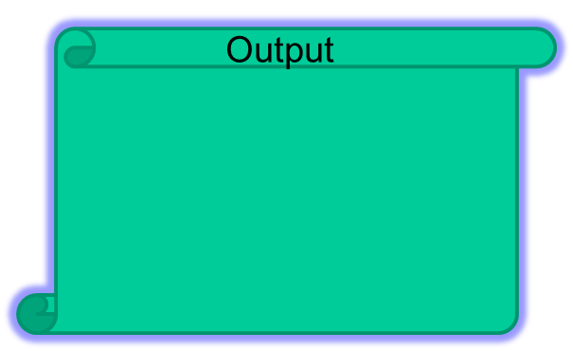

Writing to a Web Page (Contd.)
    The writeln() method:
  Appends a carriage return character to the end of the output.
  For example:
    <html>
    <body>
    <pre>
    <script type="text/javascript">
    document.writeln("Hi!");
    document.writeln("Welcome to our site!");
    document.write("Have a ");
    document.write("great day");
    </script>
    </pre>
    </body>
    </html>

Slide 8
Accessing the Elements of a Web Page
JavaScript enables you to access the elements of a Web page at runtime and change their content.
JavaScript provides the getElementById() method to access and manipulate the elements such, as textbox, textarea, drop-down list, and HTML tags on a Web page at runtime.

Slide 9
Accessing the Elements of a Web Page (Contd.)
The getElementById()method:
  Uses the ID of HTML elements to access and manipulate their content.
  Syntax:
    document.getElementById("id_of_the_element");
  For example:
var name = document.getElementById("text1").value;
To retrieve and change the text of the HTML elements, the innerHTML property with the document.getElementById()method is used.

Slide 10
Accessing the Elements of a Web Page (Contd.)
To retrieve and change the text of the HTML elements, the innerHTML property with the document.getElementById() method is used.
For example:
  <html>
  <script type="text/javascript">
  function replacetext()
  {
  document.getElementById("para1").innerHTML="Changed the content by using the innerHTML property of getElementById() method";
  }
  </script>
Replaces the text of the <p> element

Slide 11
Accessing the Elements of a Web Page (Contd.)
  <body>
  <p id="para1">A simple paragraph</p>
  <input type="button" value="Change text" onclick="replacetext()"/>
  </body>
  </html>

Slide 12
Summary
  In this session, you learned that:
  The document.write() method enables users to write text on a Web page.
  The writeln() method also writes text on a Web page. The only difference is that the writeln() method appends a carriage return character to the end of the output.
  The document.getElementById()method uses the ID of the HTML elements to access and manipulate their content.

